Slide 1


Michael
5/13/2025

Slide 2

Outline
Executive Summary
Introduction
Methodology
Results
Conclusion
Appendix

Slide 3
Executive Summary
High-level description of project goals: predicting Falcon 9 the first stage landing success to assess launch cost efficiency

Slide 4
Introduction
SpaceX has revolutionized the aerospace industry by introducing reusable rocket technology. One of the most significant cost-saving measures is the ability to recover and reuse the Falcon 9 rocket's first stage. A successful landing significantly reduces the cost of a launch, bringing it down from approximately $165 million to just $62 million.
Problems you want to find answers:
1. Can we predict whether the first stage of falcon 9 will land successfully based on launch characteristics?
2. What is the predicted cost of a SpaceX Launch?
3. How can visualizations help decision-makers quickly identify patterns in successful vs failed landings?

Slide 5

Section 1

Slide 6
Methodology
Executive Summary
Data collection methodology:
Describe how data was collected
Perform data wrangling
Describe how data was processed
Perform exploratory data analysis (EDA) using visualization and SQL
Perform interactive visual analytics using Folium and Plotly Dash
Perform predictive analysis using classification models
How to build, tune, evaluate classification models

Slide 7
Data Collection
Data was collected from the SpaceX URL using an API request
This allowed us to get data straight from the source

Slide 8
Data Collection – SpaceX API
Launch Data from API
(SpaceX REST API)
To begin the analysis, data was collected directly from the publicly available SpaceX RESTful API
This API provides detailed information about Falcon 9 rocket launches, including mission details, payloads, rocket specifications, launch sites, and landing outcomes
By retrieving raw JSON responses, data was normalized by using pandas.json_normalize
Link
https://github.com/poofmagicdragon/Coursera-Data-Science-Submissions/blob/f2295d2a693b0740813ba68f9903065609937ab1/jupyter-labs-spacex-data-collection-api.ipynb
Raw JSON Data Retrieved
Normalize JSON Structure (pandas.json_normalize)

Slide 9
Data Collection - Scraping
Additional Data via Web Scraping (Wikipedia)
The scaping process was conducted using Python’s requests library to fetch HTML content and BeautifulSoup to parse and extract relevant information
Link
https://github.com/poofmagicdragon/Coursera-Data-Science-Submissions/blob/f2295d2a693b0740813ba68f9903065609937ab1/jupyter-labs-spacex-data-collection-api.ipynb
Combine API and Scraped Data
Clean and Filter Columns
Final Structured Dataset (for EDA & Modeling)

Slide 10
Data Wrangling
Data wrangling was done by converting nested JSON responses into flat tables using json_normalize
Columns like payload mass, orbit type, and launch site were standardized, and missing values were handled through imputation or removal
Categorical variables were transformed using one hot encoding
Link
https://github.com/poofmagicdragon/Coursera-Data-Science-Submissions/blob/a7367941173bd9941c8d4400fcfe2918cd71bb73/labs-jupyter-spacex-Data%20wrangling.ipynb

Slide 11
EDA with Data Visualization
Graphs we used include:
A scatter plot Flight number vs Launch Site
A scatter plot of Payload Mass vs Launch Site
A bar chart of Class vs Orbit
Link
https://github.com/poofmagicdragon/Coursera-Data-Science-Submissions/blob/7fd4d18f79e662c9998f7183dbac8f4f4abc2c7f/edadataviz.ipynb

Slide 12
EDA with SQL
SQL Queries include:
Names of unique launch sites
Total payload mass carried by boosters launched by NASA
Average payload mass carried by booster version F9 v1.1
Link
https://github.com/poofmagicdragon/Coursera-Data-Science-Submissions/blob/7fd4d18f79e662c9998f7183dbac8f4f4abc2c7f/edadataviz.ipynb

Slide 13
Build an Interactive Map with Folium
Circles are used to highlight the location of the launch site to make it easier to see
Launch outcomes were added to each site so we can see which ones have the most number of successes

Slide 14
Build a Dashboard with Plotly Dash
Summarize what plots/graphs and interactions you have added to a dashboard
Explain why you added those plots and interactions
Add the GitHub URL of your completed Plotly Dash lab, as an external reference and peer-review purpose

Slide 15
Predictive Analysis (Classification)
Summarize how you built, evaluated, improved, and found the best performing classification model
You need present your model development process using key phrases and flowchart
Add the GitHub URL of your completed predictive analysis lab, as an external reference and peer-review purpose

Slide 16
Results
Exploratory data analysis results
Interactive analytics demo in screenshots
Predictive analysis results

Slide 17

Section 2

Slide 18
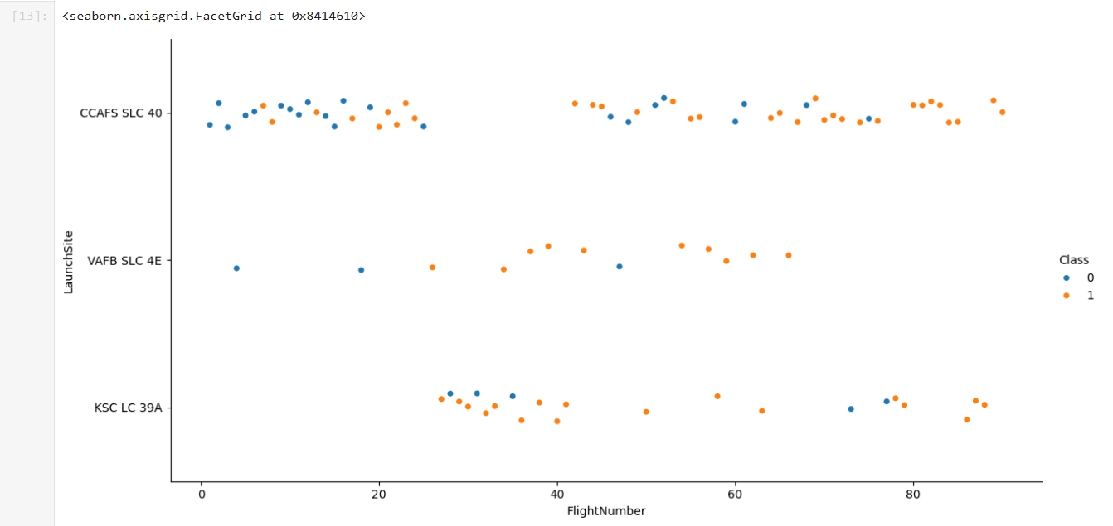
Flight Number vs. Launch Site
We can see that SLC has two clusters. The first has mostly Class 0 and the second has mostly class 1.

Slide 19
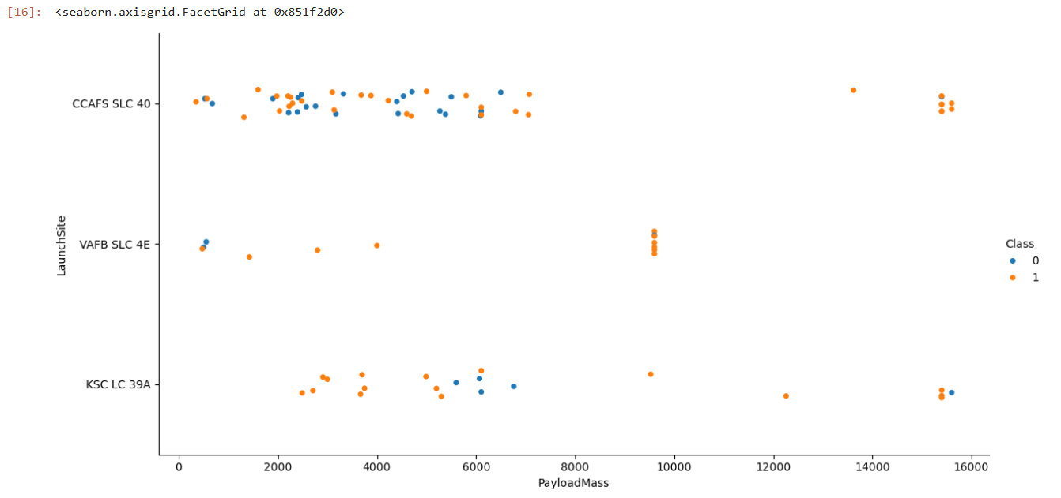
Payload vs. Launch Site
Show a scatter plot of Payload vs. Launch Site
Show the screenshot of the scatter plot with explanations

Slide 20
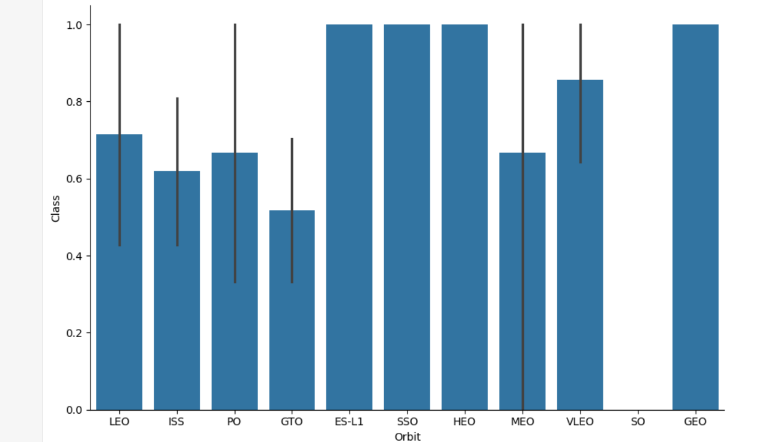
Success Rate vs. Orbit Type

Slide 21
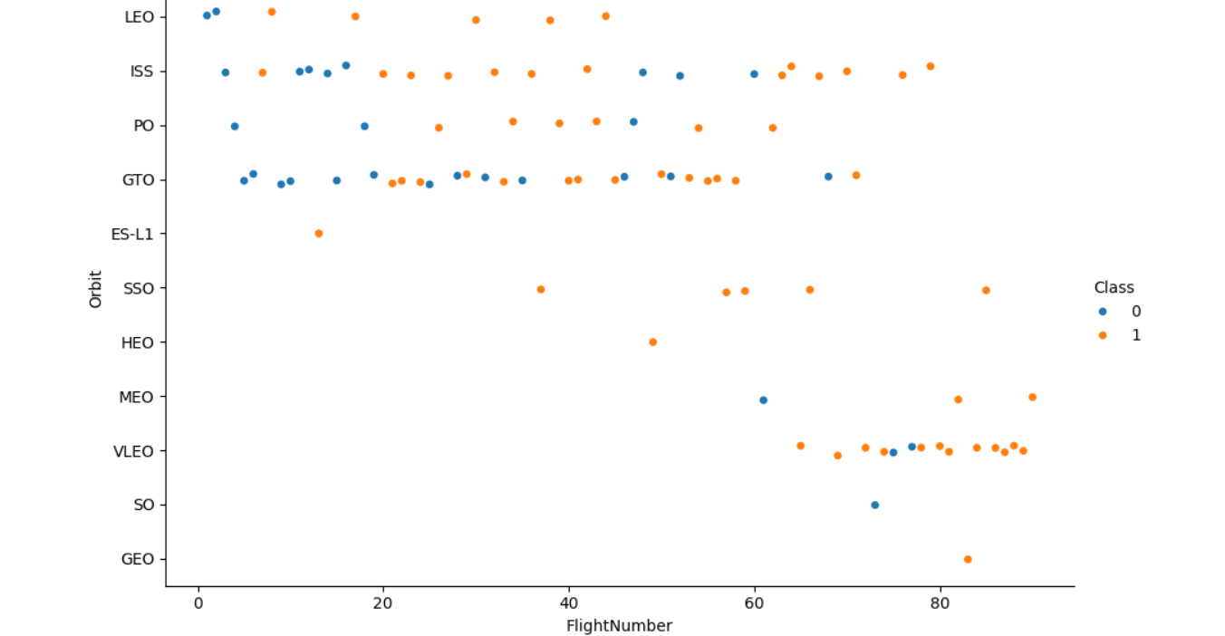
Flight Number vs. Orbit Type

Slide 22
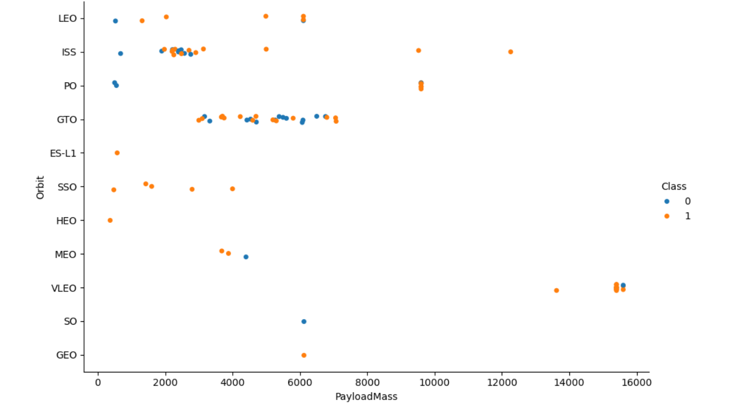
Payload vs. Orbit Type

Slide 23
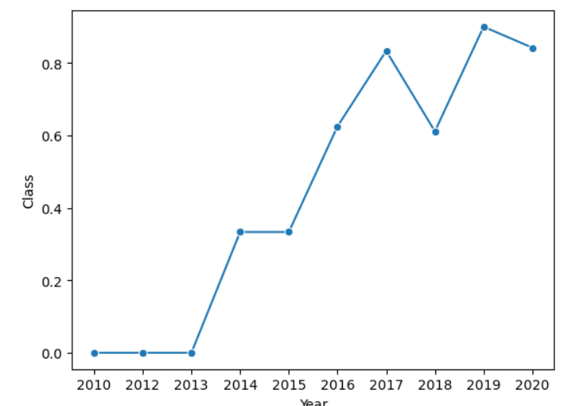
Launch Success Yearly Trend

Slide 24
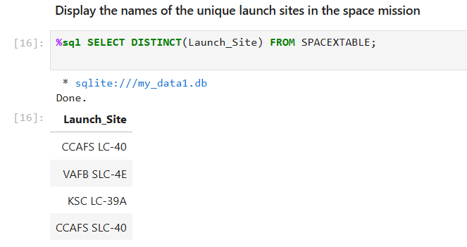
All Launch Site Names

Slide 25
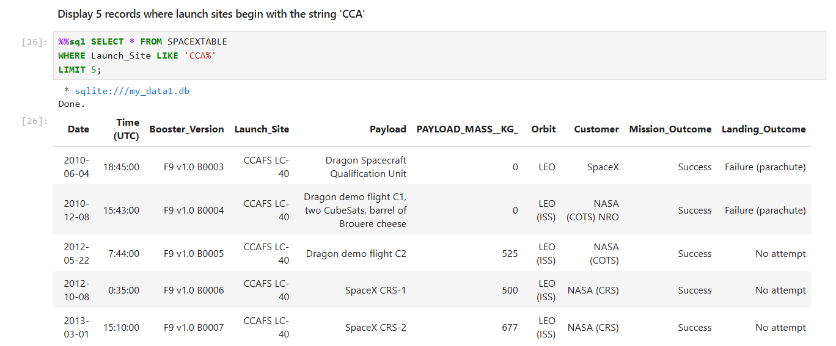
Launch Site Names Begin with 'CCA'

Slide 26
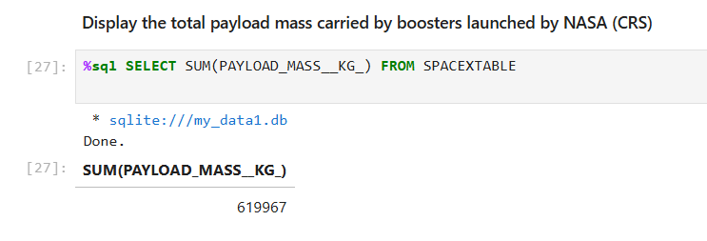
Total Payload Mass

Slide 27
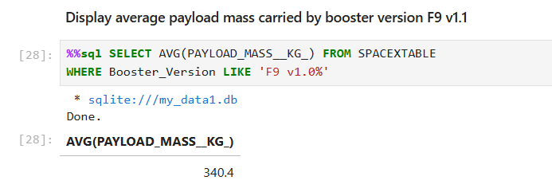
Average Payload Mass by F9 v1.1

Slide 28
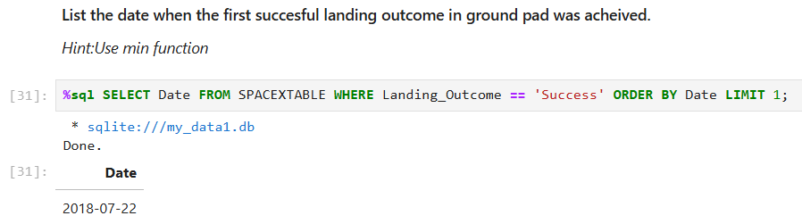
First Successful Ground Landing Date

Slide 29
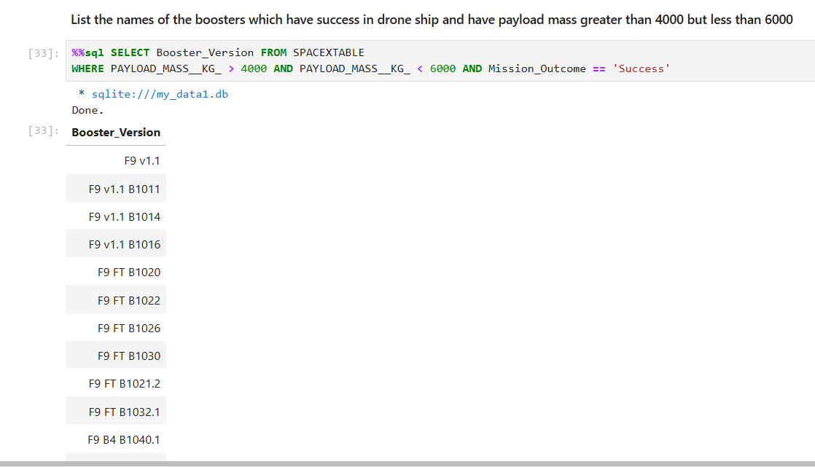
Successful Drone Ship Landing with Payload between 4000 and 6000

Slide 30
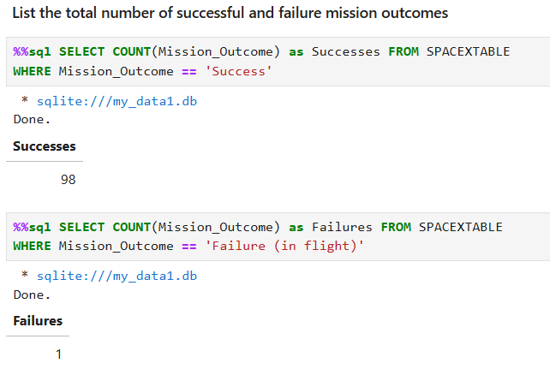
Total Number of Successful and Failure Mission Outcomes

Slide 31
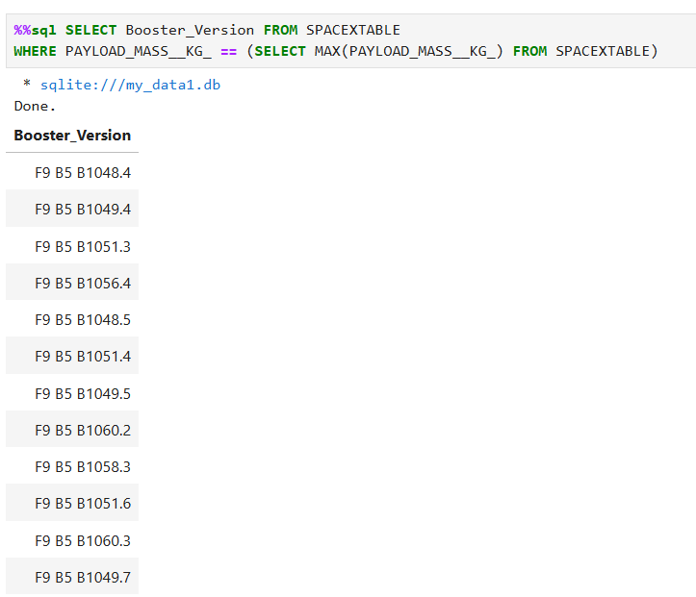
Boosters Carried Maximum Payload

Slide 32
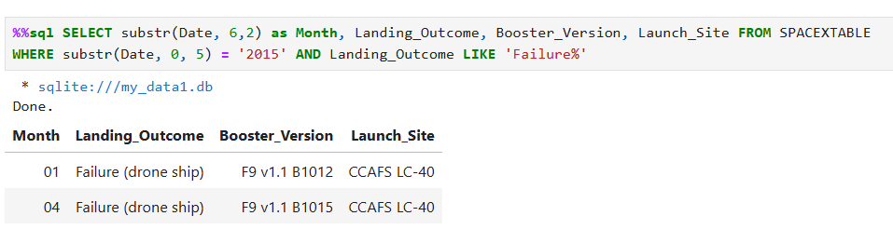
2015 Launch Records

Slide 33
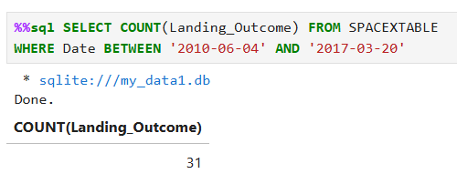
Rank Landing Outcomes Between 2010-06-04 and 2017-03-20

Slide 34

Section 3

Slide 35
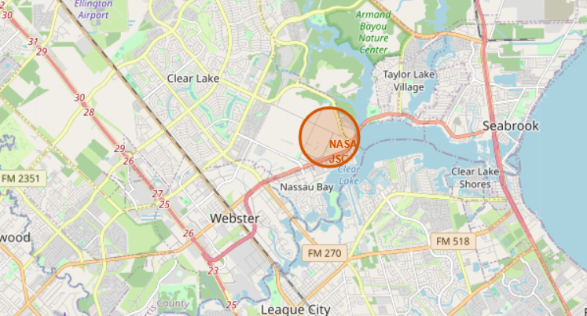
Houston, Texas NASA Johnson Space Center

Slide 36
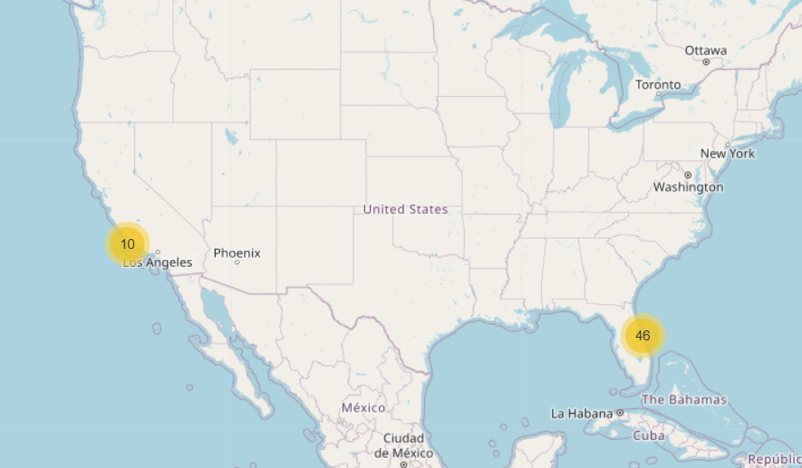
Number of Launches from Different Stations

Slide 37
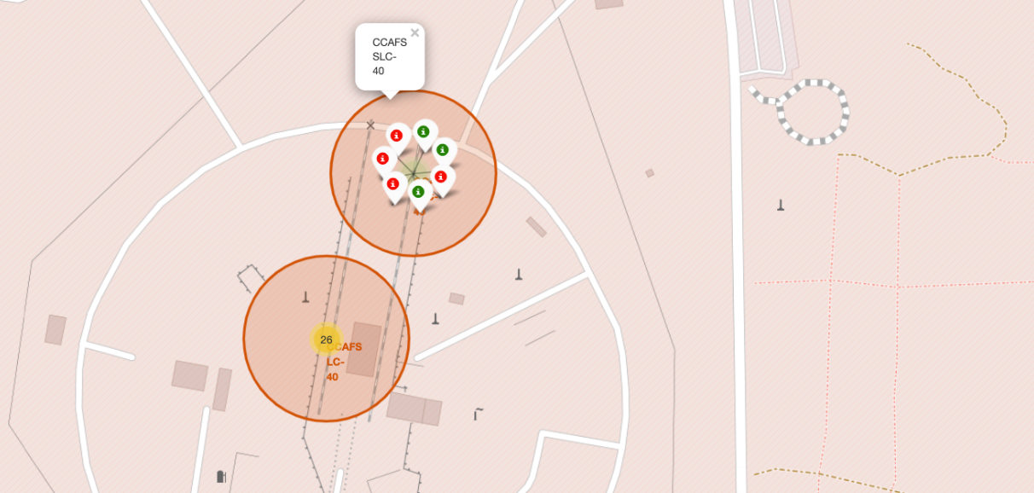
Successes of Launches at Certain Space Stations

Slide 38

Section 4

Slide 39
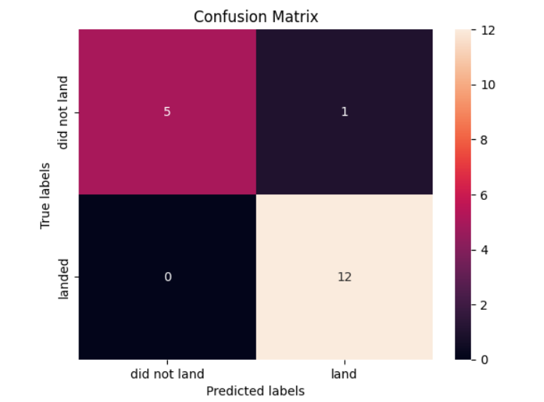
Confusion Matrix

Slide 40
Conclusions
This project set out to analyze and predict the success of SpaceX Falcon 9 first-stage landings
From exploratory analysis payload mass had correlations with success rates, and certain orbit types
We also used machine learning and grid search based on various launch features
These models offer potential for predicting the likelihood of landing success.

Slide 41


